Slide 1
Remedial Reading Kit: DEVELOP Workshop
Welcome Teachers!
Notes:
Put books from decode system out on tables

Slide 2
Upon arrival, please sign in.
Name, School, Email, Phone

Slide 3
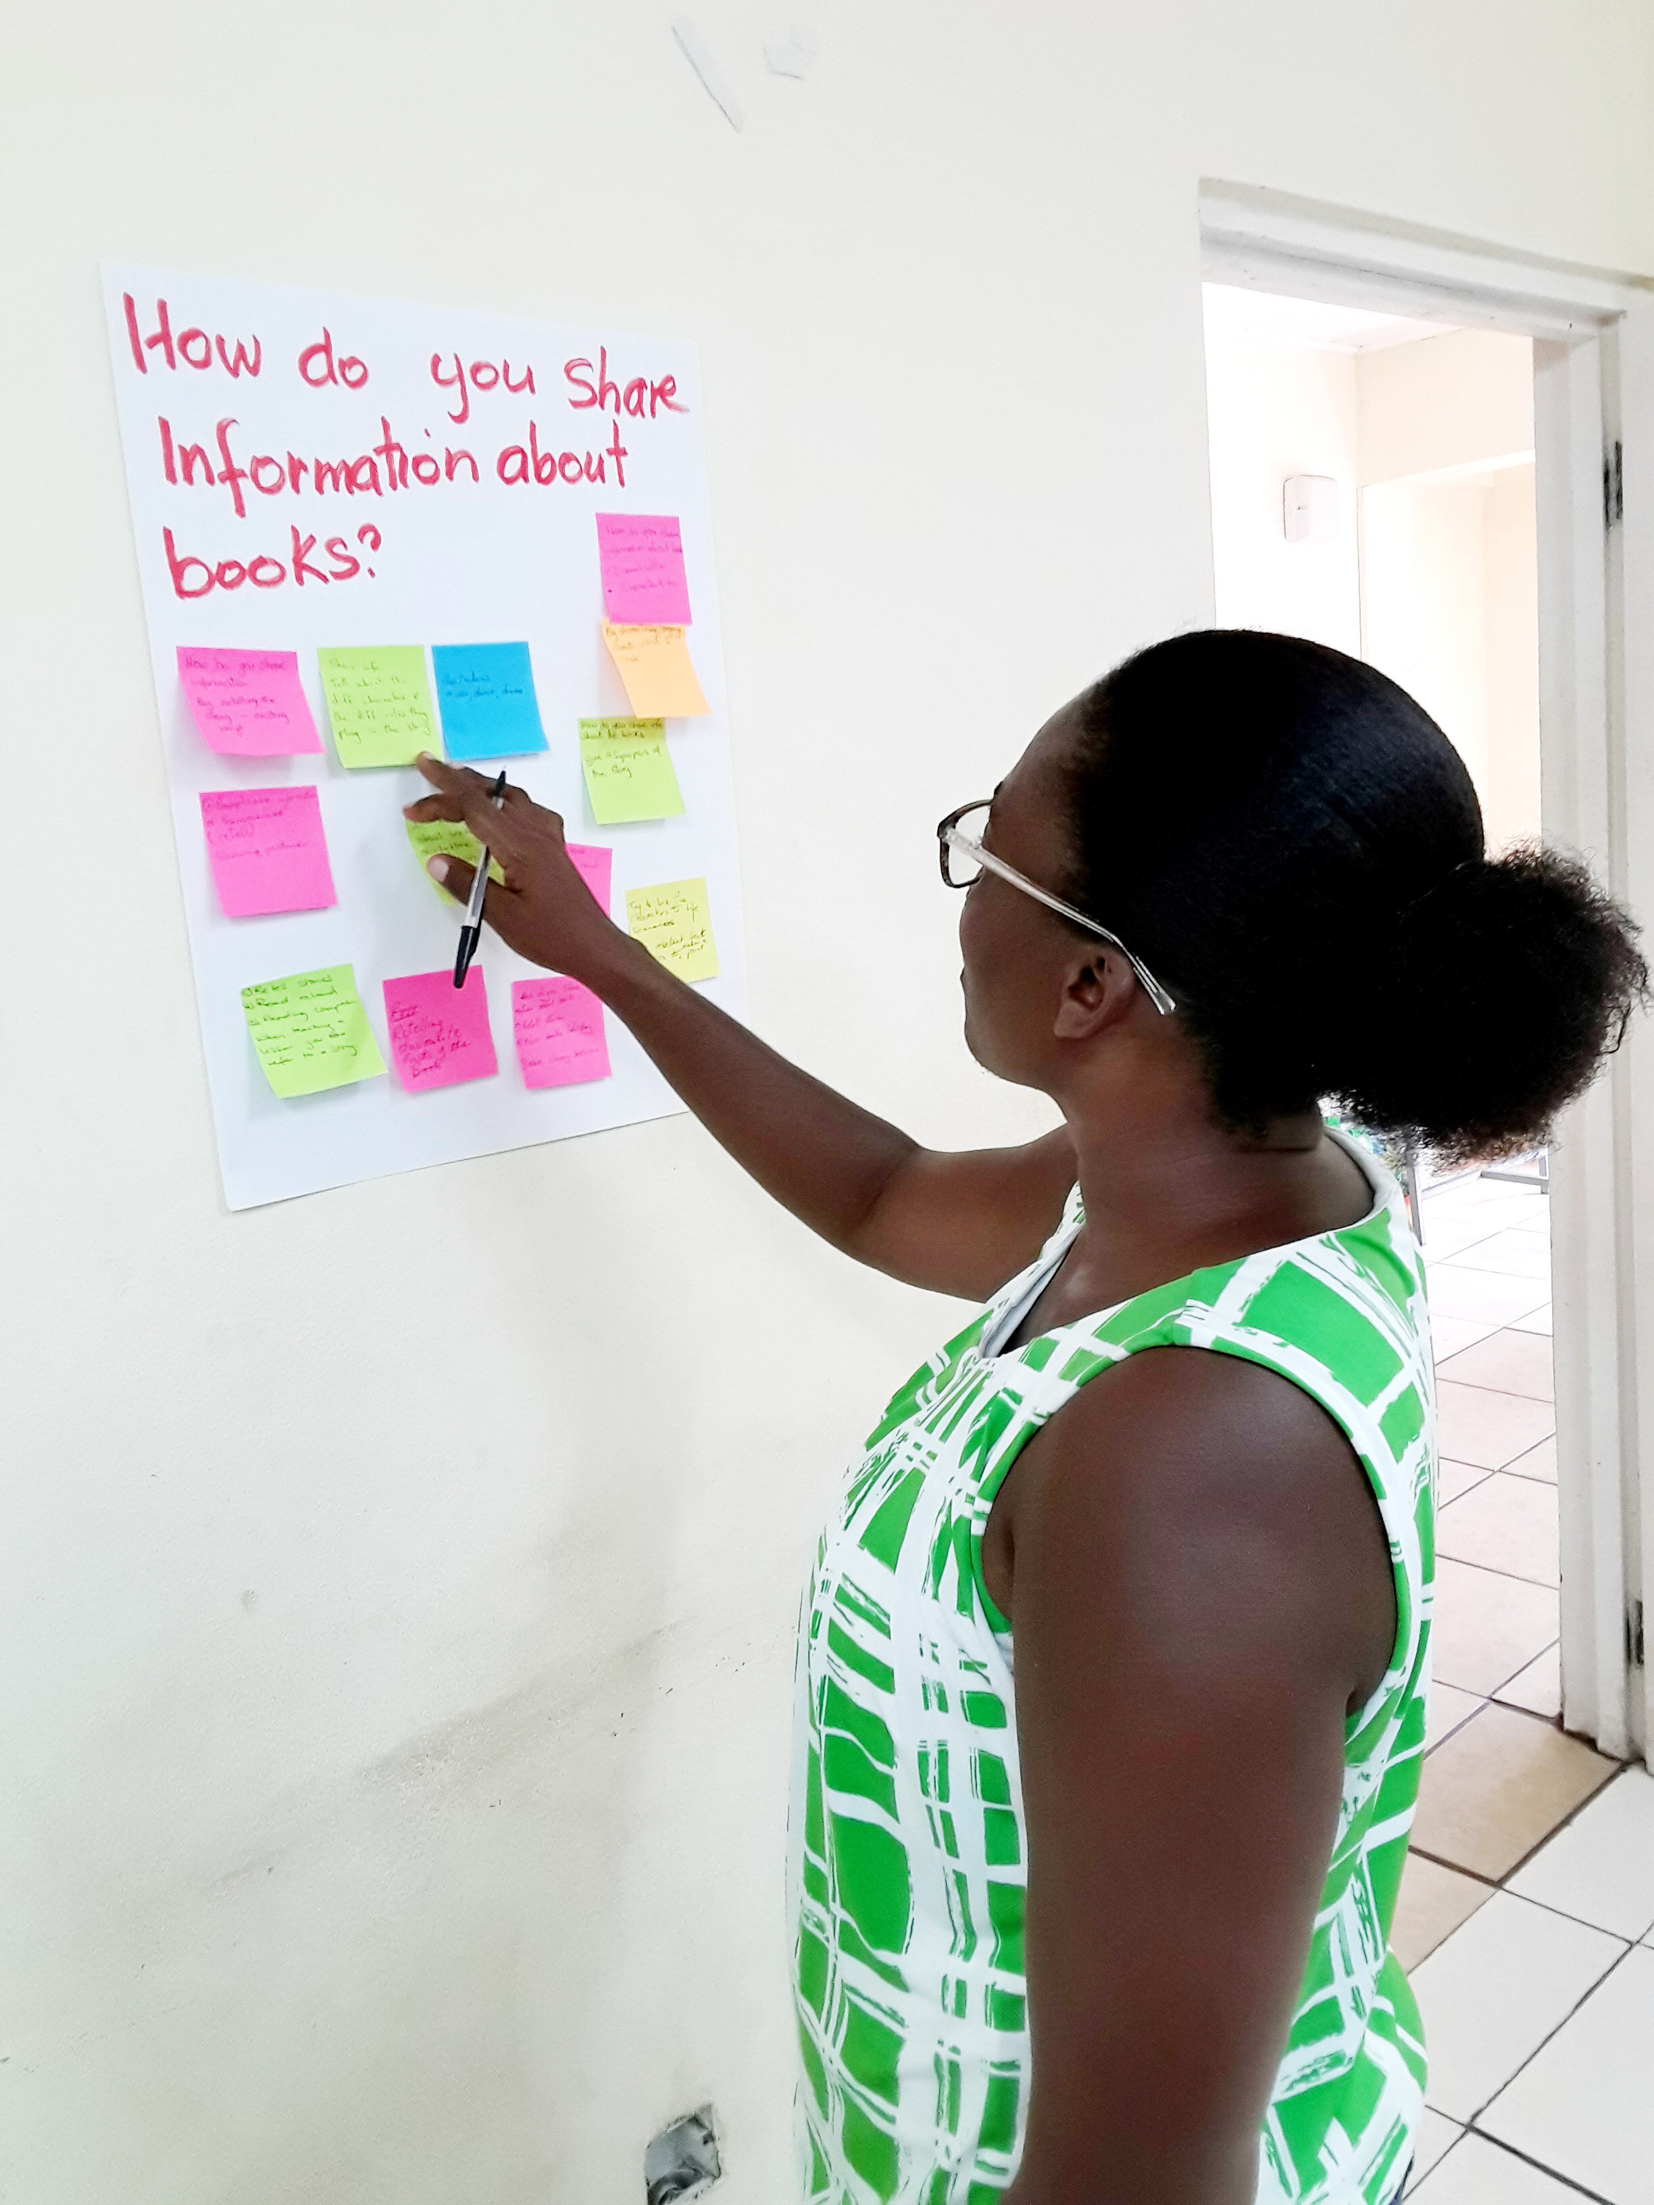
What is your favorite book?
How are you already using the kit?
What is your greatest challenge when teaching reading?
What do you hope to learn from this workshop?
DIRECTIONS: Write the answer to the following 4 questions on each sticky note. Place it underneath the corresponding questions displayed around the room.
Notes:
Give the directive to take a few moments and write responses on each of the three sticky notes that were handed out. Get up out of your seat and put the sticky note answer on a different wall (for each question). Walk around and read what your colleagues wrote on their sticky notes hung up on the wall. Call on volunteers to share one thing their colleagues wrote for each.

Slide 4

Introductions
My name is …?
At which school do I teach?
What form(s) I teach?
What is your favorite book?
Notes:
Who I am, Hands Across the Sea, that I love them and their island. Ask who they are, what school do they teach at, grade level they teach, why they became a teacher (inspiration)

Slide 5

Teachers as readers.
How can we tell our students that they need to read if we are not reading ourselves?
  Setting an example for our students.
  Changing the mindset around reading.
  Reading is something we do with our students to model for them what an adult who reads looks like.
Read (or listen to) books during our morning and evening commute (on the bus)?
Read to our own children at home in the evenings?
The books in your school’s library are there for YOU too!

Slide 6

How will reading yourself enable you to be a better remedial reading teacher?
You will know what books exist in your library to recommend to students.
You will be able to share your enthusiasm of reading with your students about what you are reading or have recently read.
More reasons?

Slide 7
Workshop Objectives:
1. Teachers as readers.
2. What is the Remedial Reading Kit from Hands Across the Sea?
3. Best Practices with the RR Kit.
4. How does the DECODE and DEVELOP kits work
5. How to integrate the other resources from the kit?
6. What if my class size is too big?
7. Practical strategies
8. Your Turn: Building a 4-station lesson plan

Slide 8

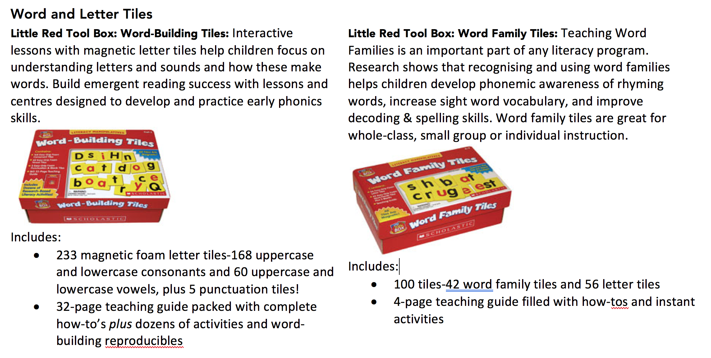

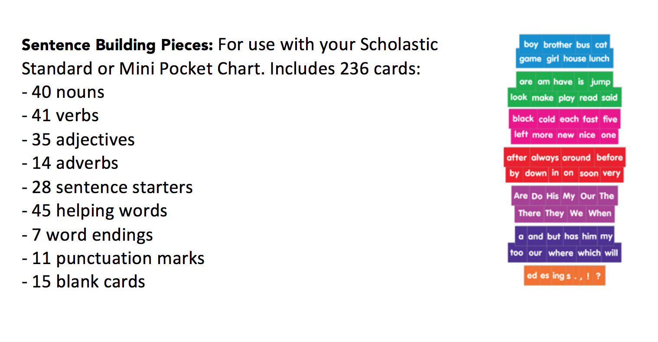
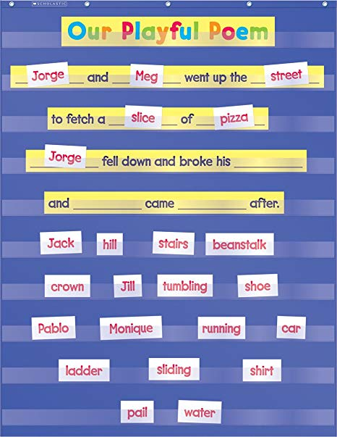

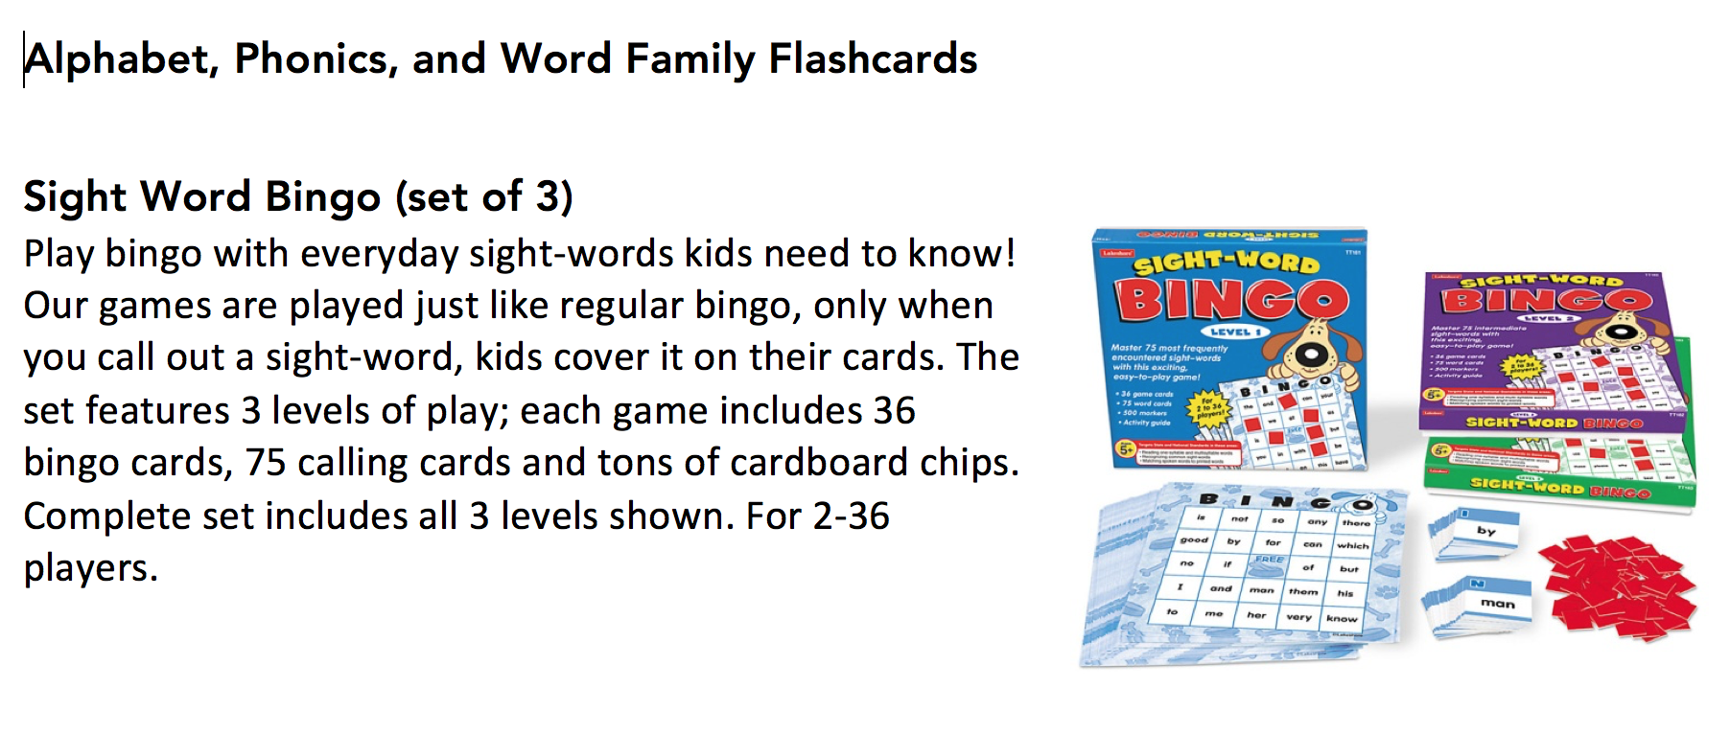
What’s in the kit?
As we share and explain the items in the kit, consider how you currently use these resources to teach reading, and…
How you can use these resources to make teaching remedial reading more fun for your students?

Slide 9
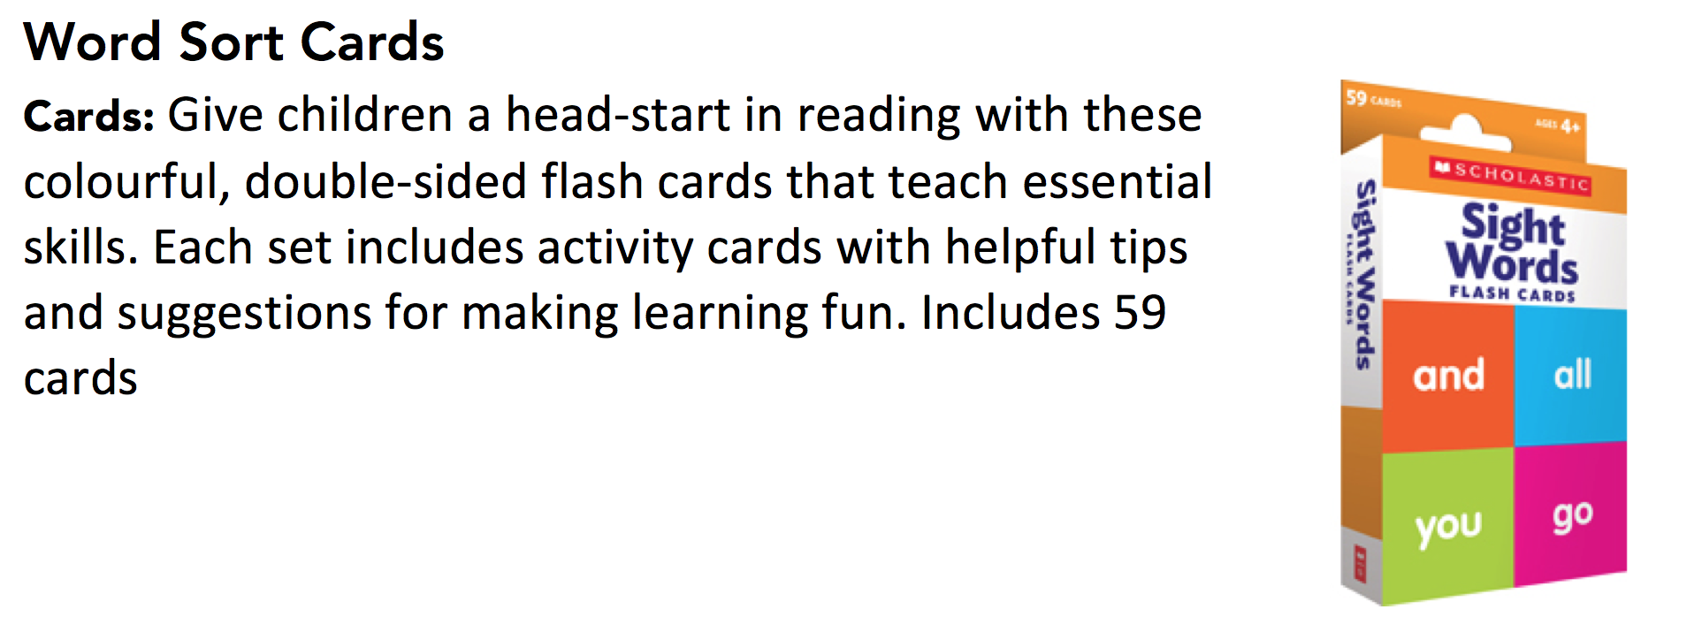
What’s in the Remedial Reading Kit?
Notes:
Each of these items comes with pre-written activities you can choose to enhance what you are teaching your students. Spelling, Rhyming, Writing, Describing.

Slide 10
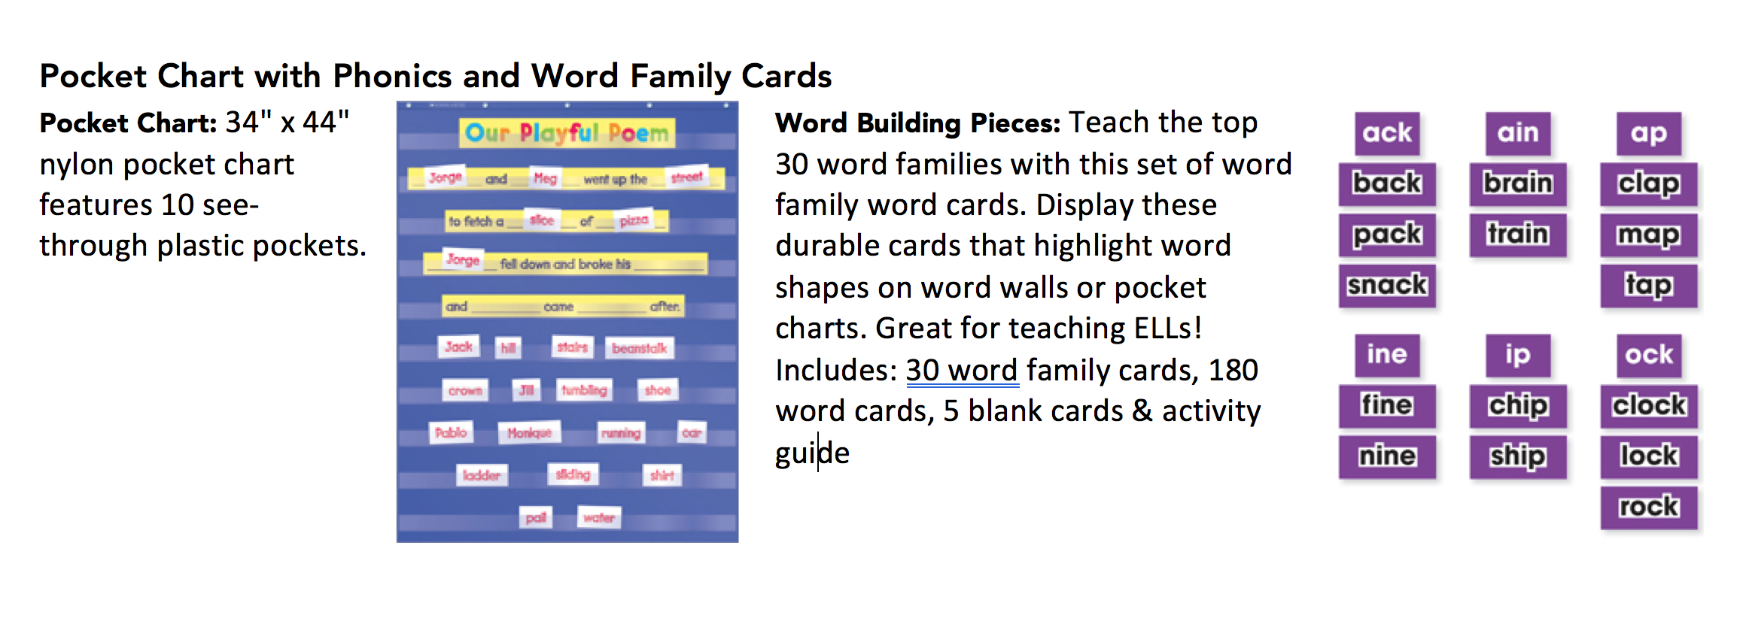
What’s in the Remedial Reading Kit?
Notes:
Each of these items comes with pre-written activities you can choose to enhance what you are teaching your students. Spelling, Rhyming, Writing, Describing.

Slide 11
What’s in the Remedial Reading Kit?
Notes:
Each of these items comes with pre-written activities you can choose to enhance what you are teaching your students. Spelling, Rhyming, Writing, Describing.

Slide 12
What’s in the Remedial Reading Kit?
Notes:
Each of these items comes with pre-written activities you can choose to enhance what you are teaching your students. Spelling, Rhyming, Writing, Describing.

Slide 13
What’s in the Remedial Reading Kit?

Slide 14

What’s in the Remedial Reading Kit?
Talk and Turn: Discuss with another teacher sitting next to you how you could use one of the resources from the kit with your students in a NEW WAY this week.
Notes:
Each of these items comes with pre-written activities you can choose to enhance what you are teaching your students. Spelling, Rhyming, Writing, Describing.

Slide 15

The DECODE System: Part 1
3 copies of each leveled book for guided reading groups
Teacher’s Manual with lesson plans, comprehension questions, activity ideas, and reproducible worksheets that correspond with each book
Notes:
Show books and show manual

Slide 16


Best Practices and Success Stories
RR Kit Best Practices
As you listen to one another, make a web (with at least 8 cells) with at least 8 best practices that you hear other remedial reading teachers using from the kit.
How have you used the kit?
What kind of progress have you seen since using the kit?
What have the students liked the most about the kit?
What do you like most about the kit?
Any specific lessons, books, or activities you’d like to share with the group?

Slide 17


The DEVELOP System: Part 2
3 copies of each leveled book for guided reading groups
Teacher’s Manual with lesson plans, comprehension questions, activity ideas, and reproducible worksheets that correspond with each book
Notes:
Show books and show manual

Slide 18
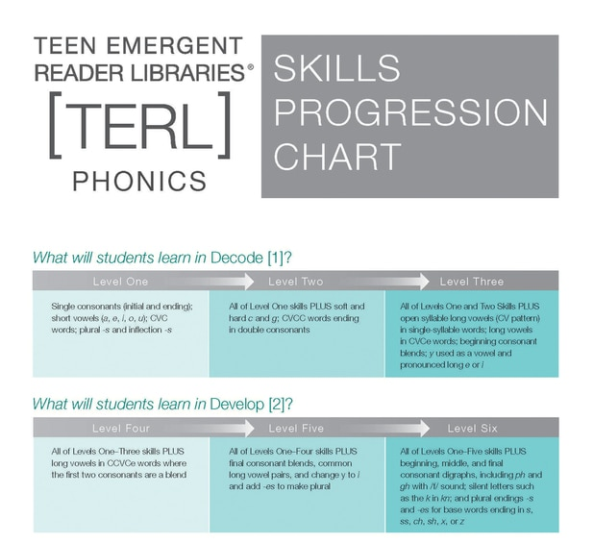
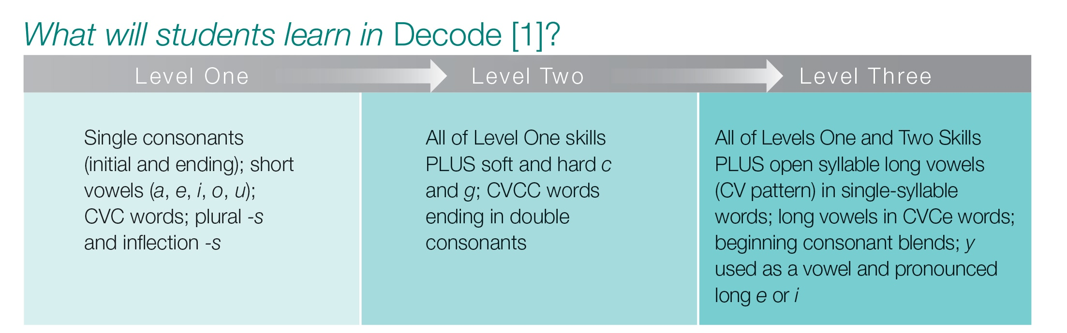
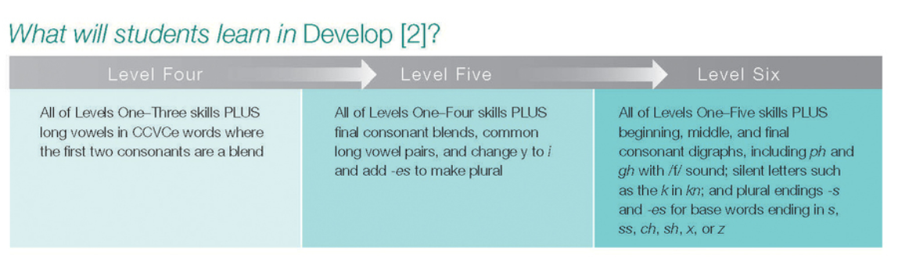

Slide 19


Why use the DECODE and DEVELOP system?
16-page books with mature, engaging content written at beginning reader levels that teach phonics and comprehension skills.
Older students are at a different cognitive level than younger students. Teaching reading to young adults should be a different process than that used to teach young children.
Many secondary students feel embarrassed or bored with the content if they have to practice reading with materials that are written for younger readers, crushing both their interest and motivation.
Talk and Turn: Discuss with another teacher sitting next to you what your greatest challenge is when teaching reading.
Notes:
The decode system is geared towards your students age.

Slide 20
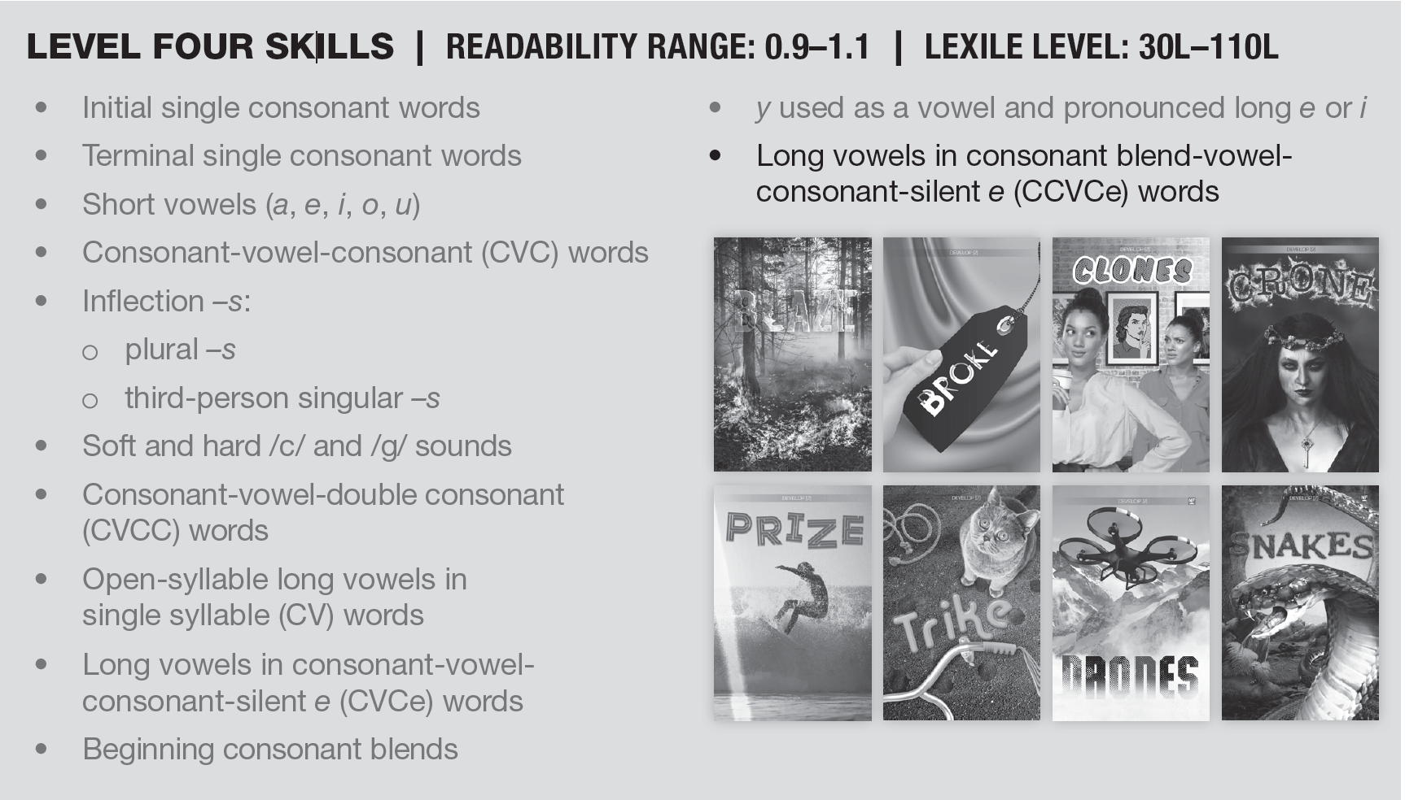
Each level builds on the next.

Slide 21
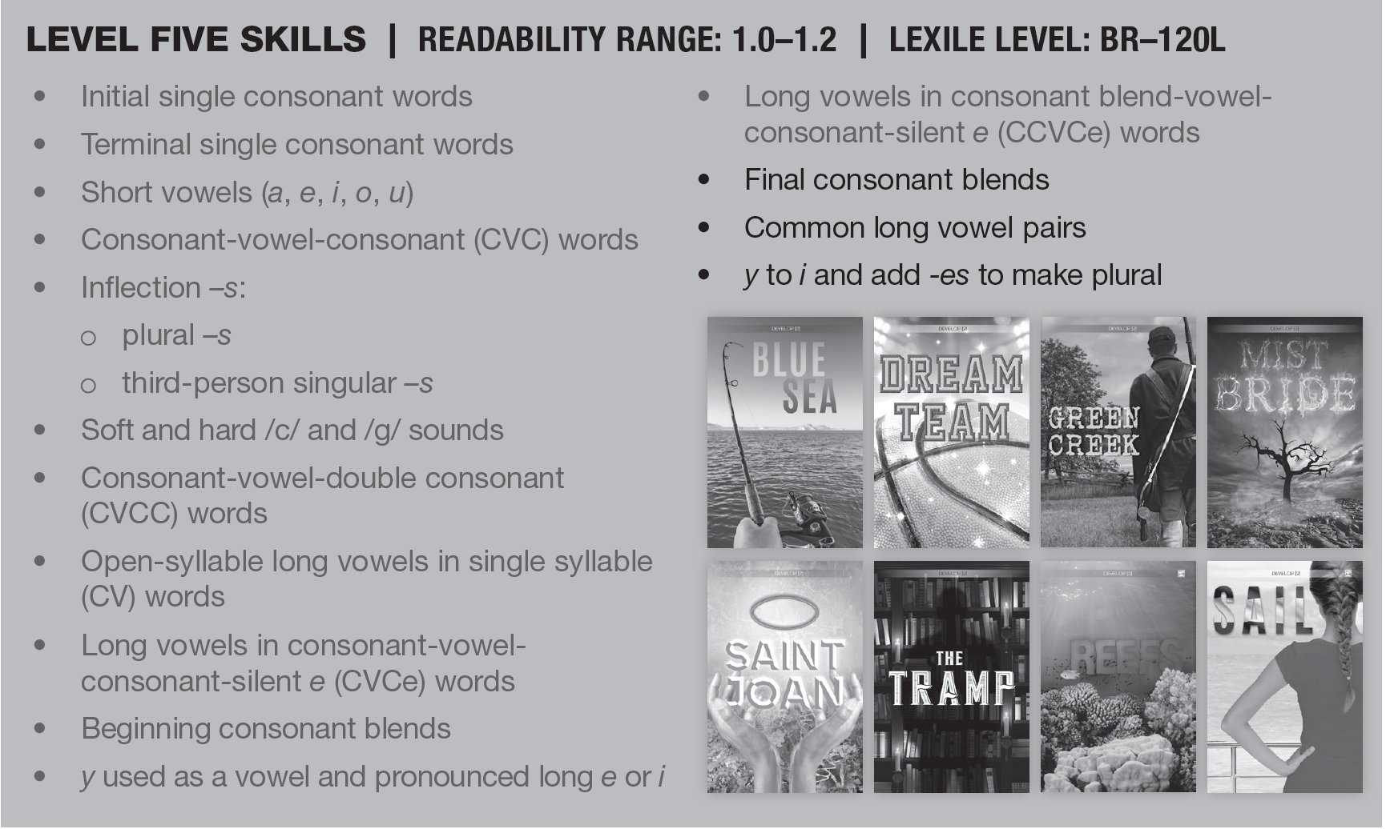
DEVELOP covers Level 4, 5, and 6 Skills.

Slide 22
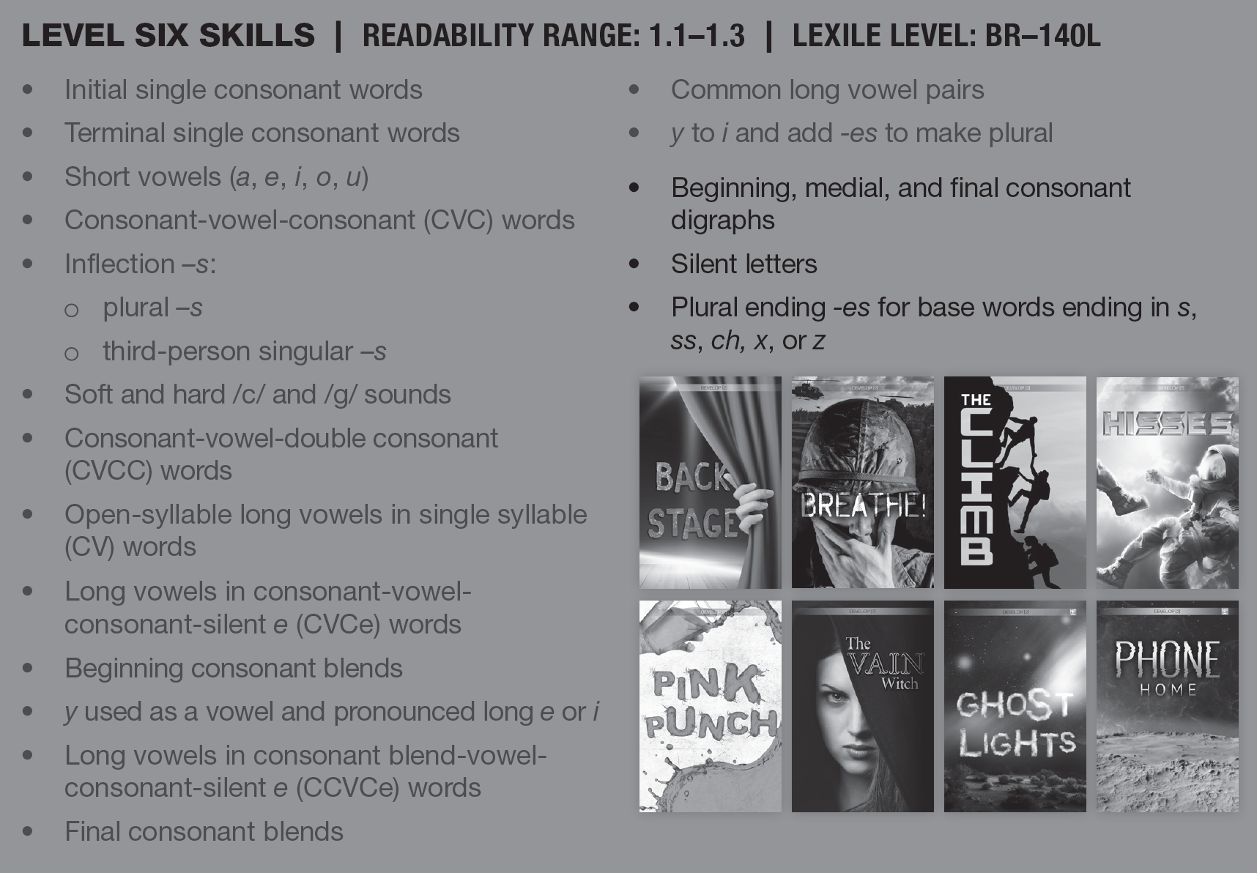
Each level builds on the next.

Slide 23
Each book has a theme, p. 14-16.
ACTIVITY: Go through the DEVELOP box to browse the books with your table and complete the following graphic organizer.
What themes from these books coincide with what students are already learning in their classes? | What themes can you relate to with your own experiences? | What themes do you think your students will enjoy reading about?
*Share a few responses from each cell of the table with the whole group.
Notes:
Have teachers turn to pages 14-15 - Give them one or two examples: The Mess is about the environment. Have them pull the books to peruse and make connections to things students might be learning in the classroom. Group them and have them share their answers.
If you don’t see connections, don’t worry or think these are not relavant. They are for teaching reading, but if content is there it is an added bonus

Slide 24
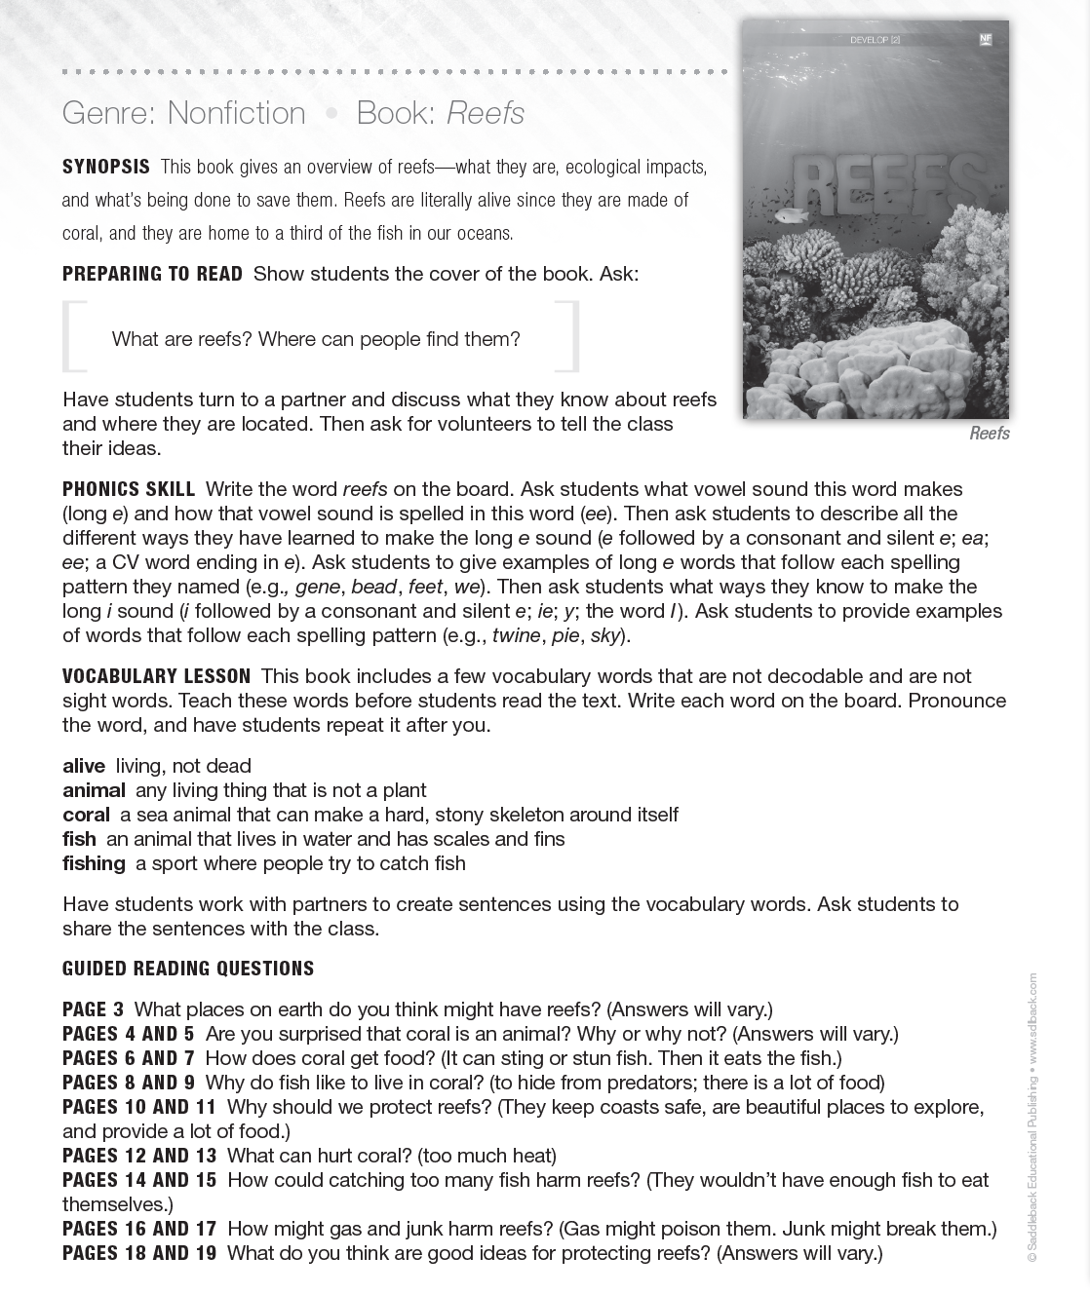
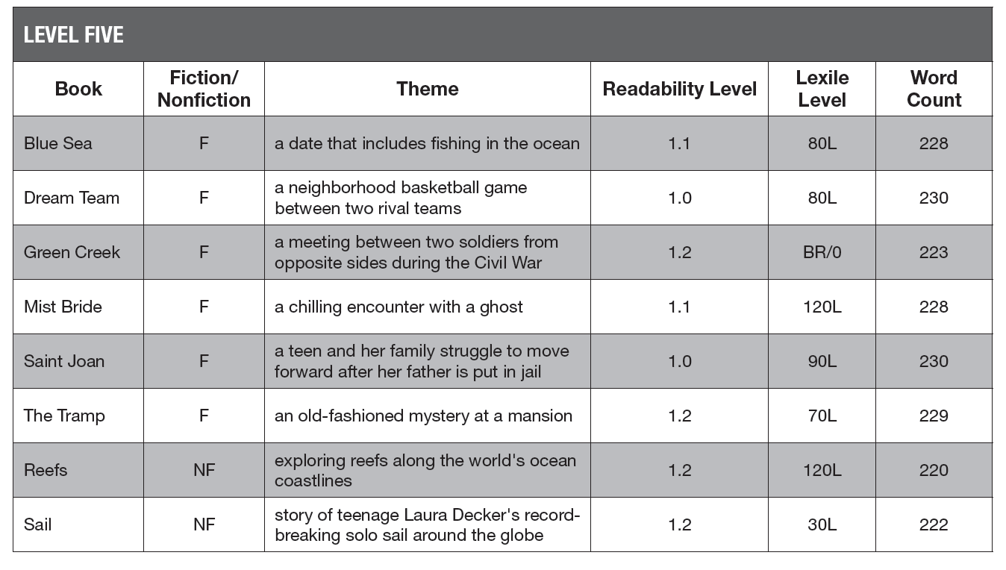
Example Lesson, p. 98-102
p. 15
Comprehension: During reading, after reading, written or verbal.

Slide 25

Exploring the Lesson p. 98-102
Group 1
Group 1
Directions:
Each group has 3 minutes to read the through the activity.
Consider the main take-away(s).
Be ready to explain and share the activity from the lesson plan with the whole group.
Group 2
Group 3
Group 4

Slide 26
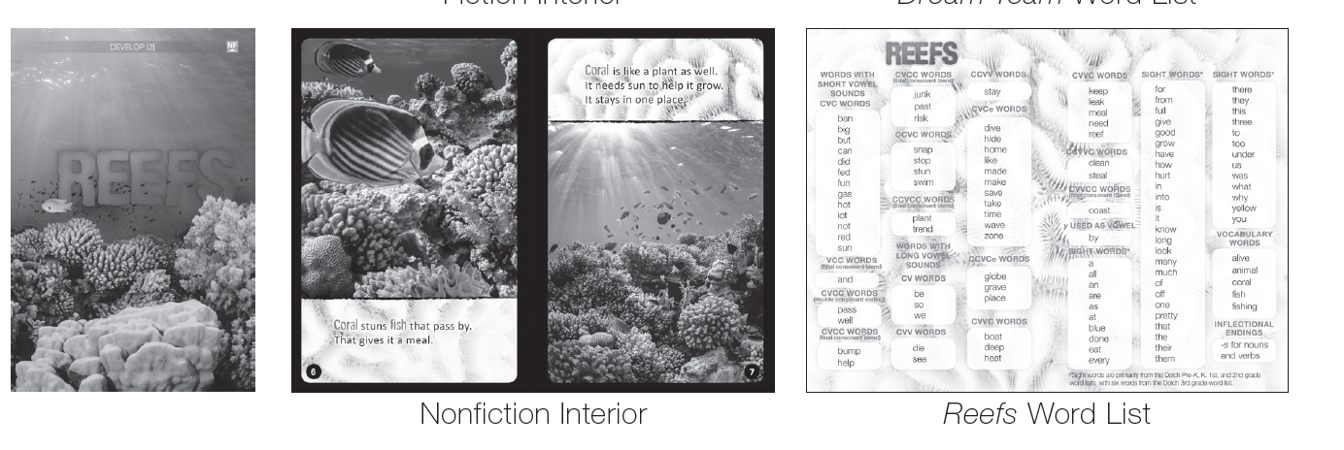
What could you and your students do with the word lists?
Word lists from the book that can be used for practice or lesson activities

Slide 27
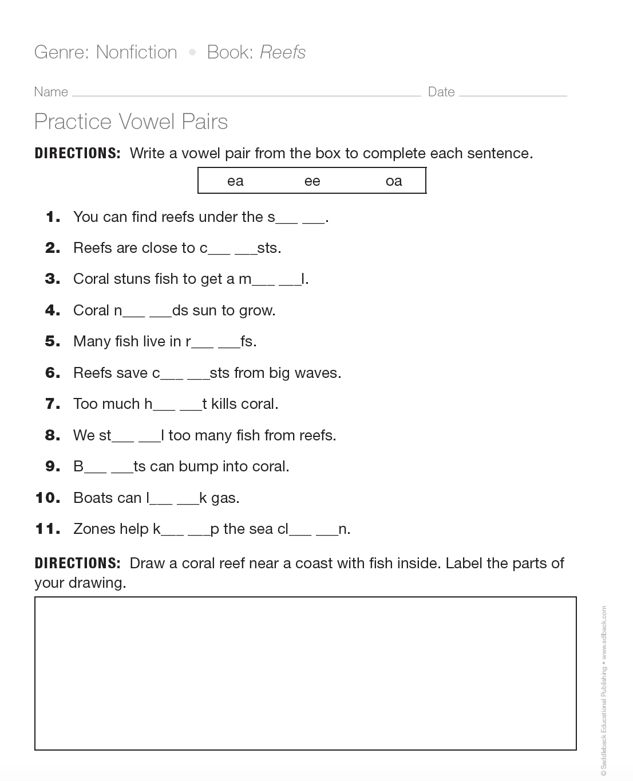
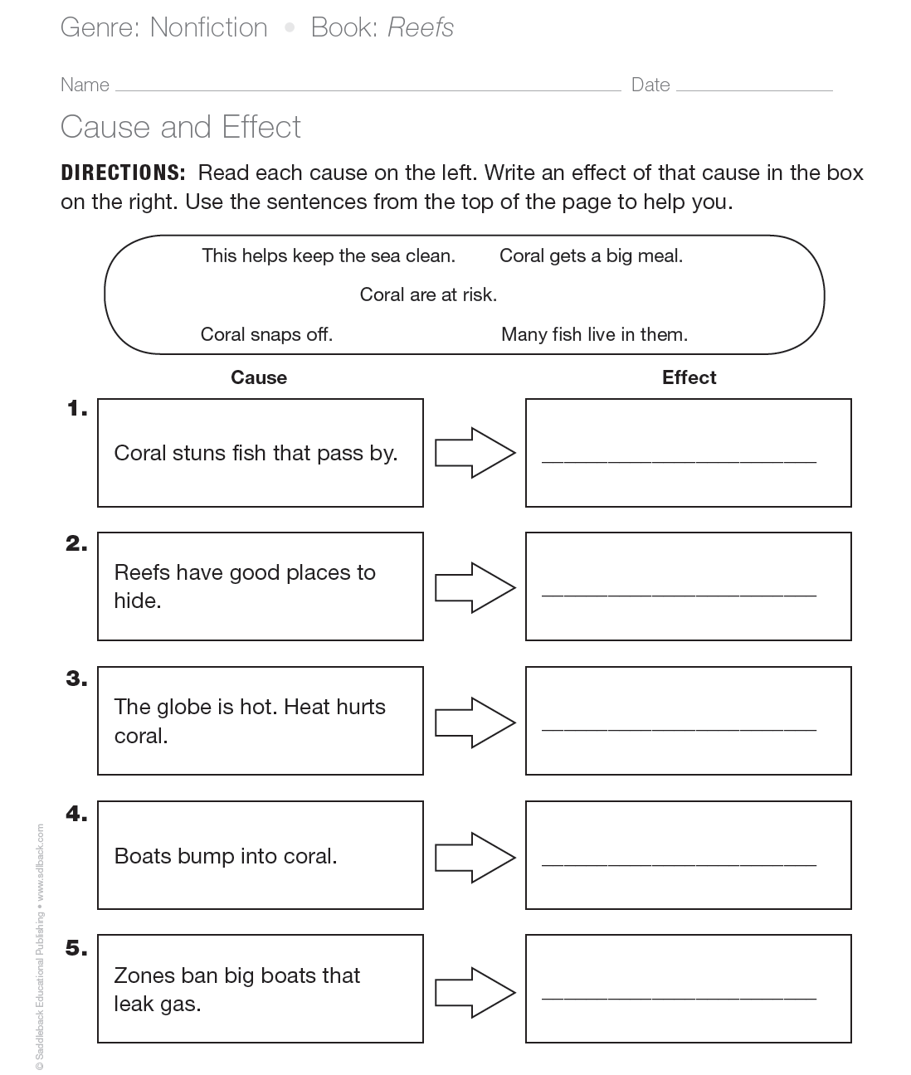
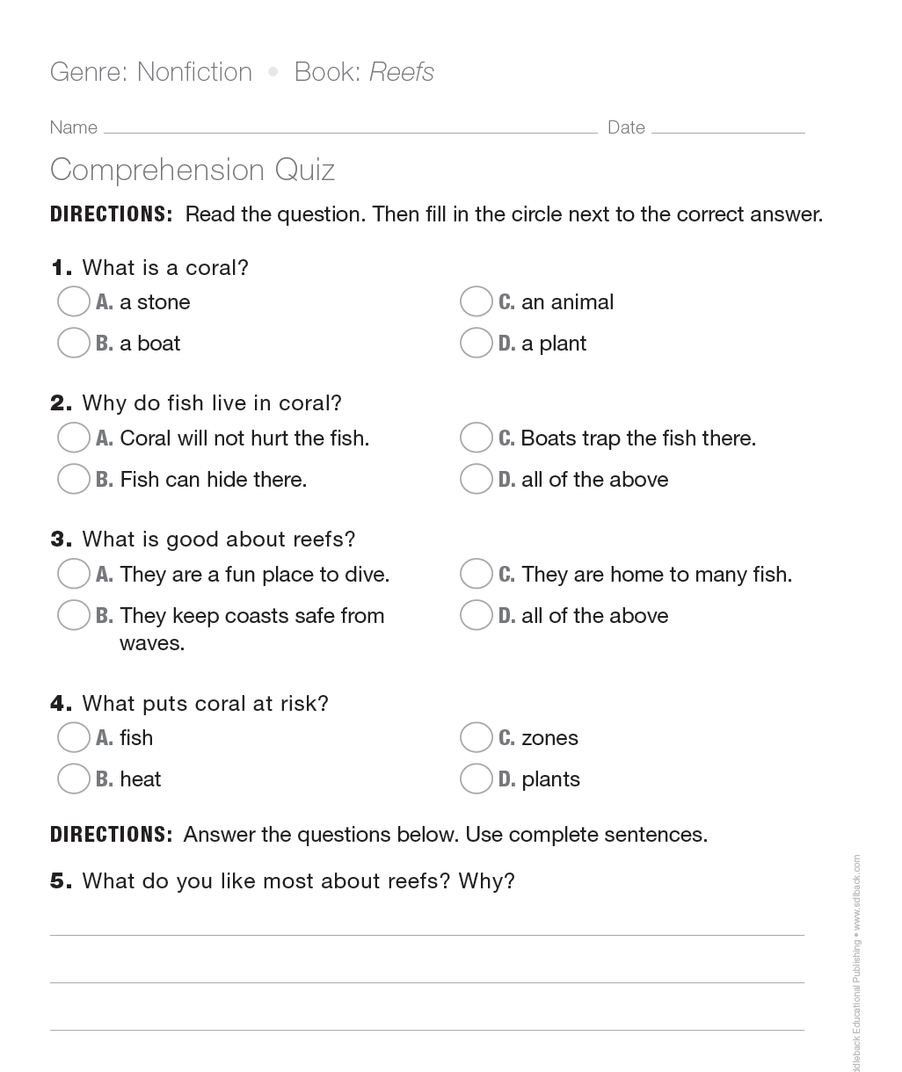
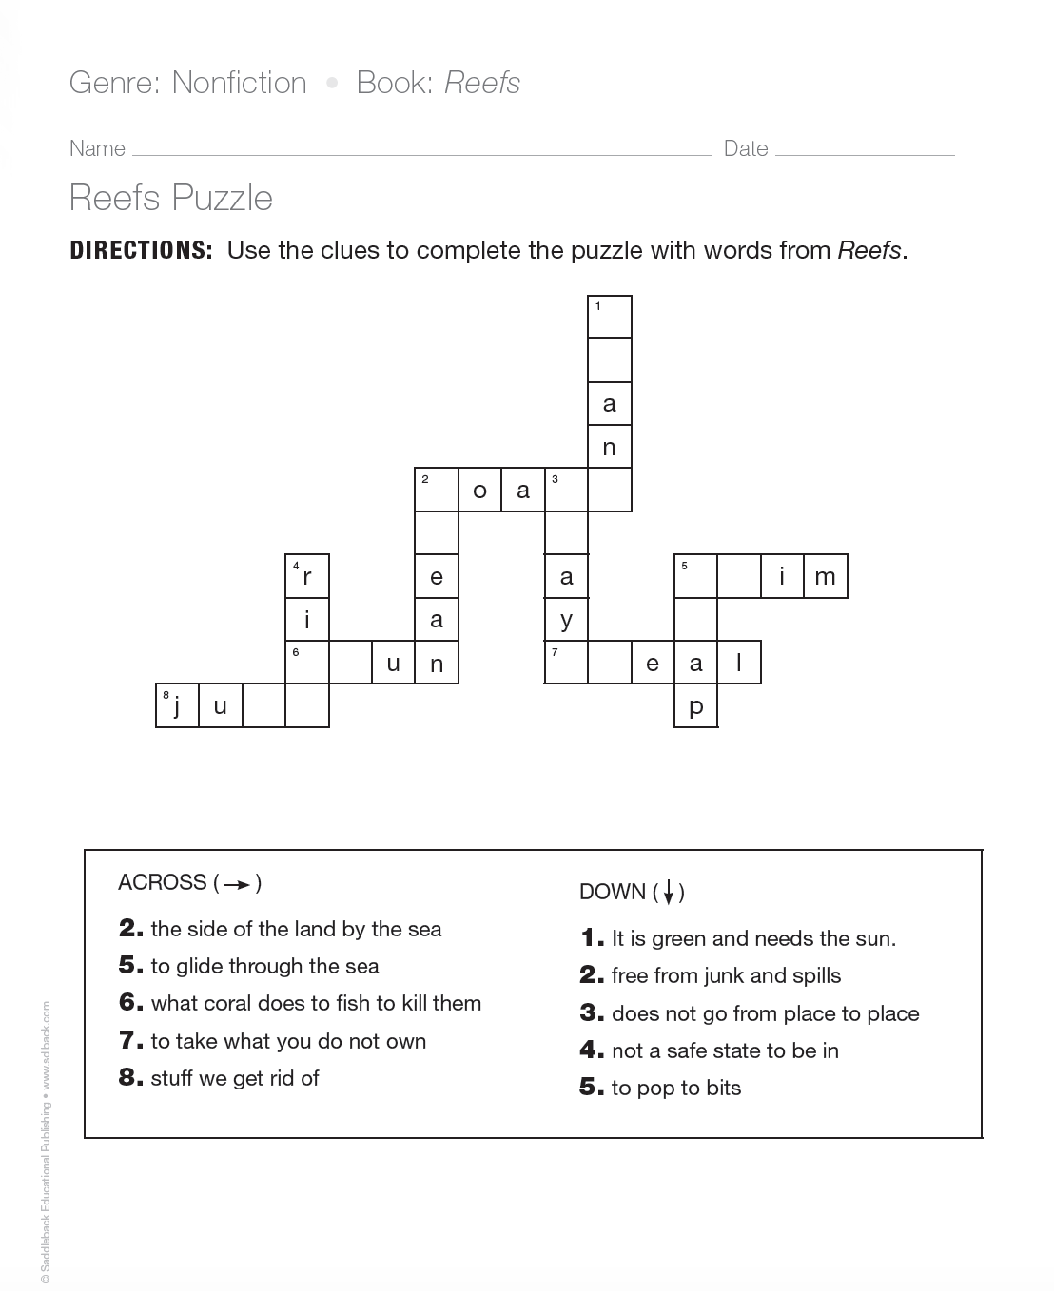
What’s included?
Lesson plan
Phonics/Vocabulary skills activity (one page for each book)
Phonics/comprehension activity (one page for each book)
Comprehension quiz (one page for each book)
Program progress chart (reproduce one for each student)

Slide 28
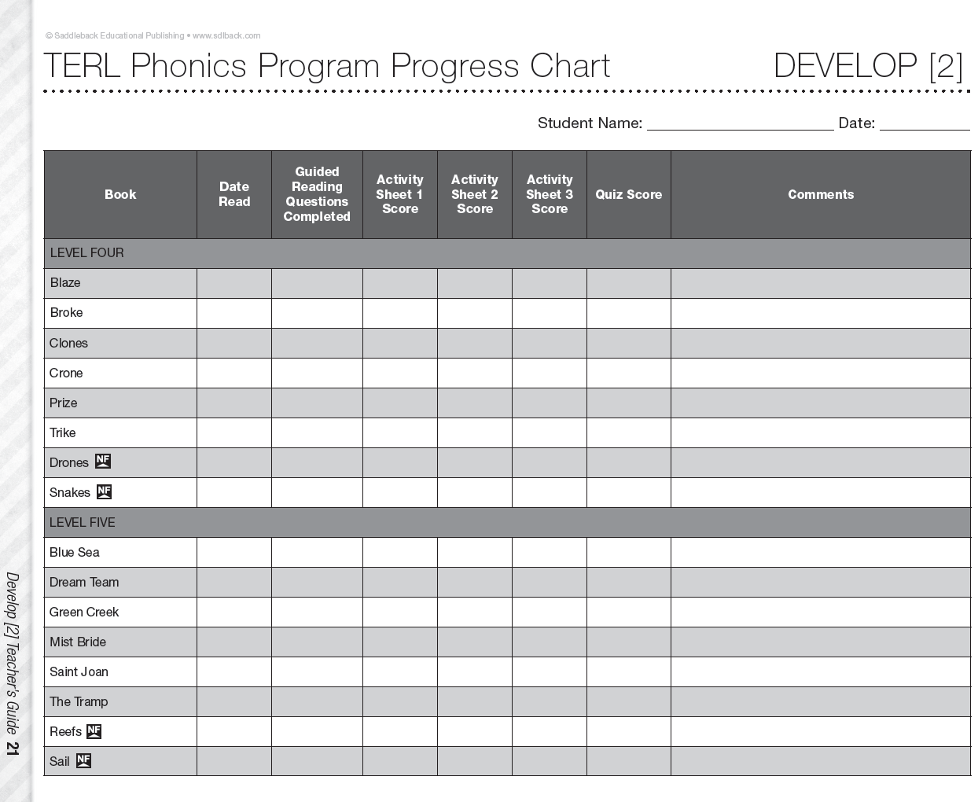
Reproduce one for each student to measure progress.

Slide 29
How to integrate the other resources from the kit?
Spell the words using the tiles and draw pictures for the meanings of each.
Write vocab. Words on index cards and use with the sentence strips to create sentences with vocabulary words.

Slide 30

What do I do with only 3 books of the same story?
Group 1
Group 2
Divide the class into four or five groups of 3 students that rotate from one “learning station” to the next every 15 minutes during the course of the hour.
Make these stations a routine, so that your students get into the habit of learning in this way.
Group 3
Group 4

Slide 31
Group1
These students are working with YOU (the teacher) to read the book and answer questions during a guided reading group session.

Slide 32
Group 2
These students are working together with the magnetic white board and word-building tiles to practice spelling vocabulary words and/or using the tiles to also complete the Phonics worksheet.
Each student must spell at least 5 complete words using the tiles.

Slide 33
Group 3
These students work with partners to create sentences using the vocabulary words from the book using the sentence strips and the pocket chart. Partners read and share their sentences with the other pairs.
Each pair must create sentences with at least 8 total words (including vocabulary word).

Slide 34
Group 4
These students work with partners to spell out the vocabulary words from the book with the Bananagrams and complete the crossword puzzle worksheet.
After completing the worksheet, students continue to build onto the crossword puzzle with new words with the Bananagrams.

Slide 35

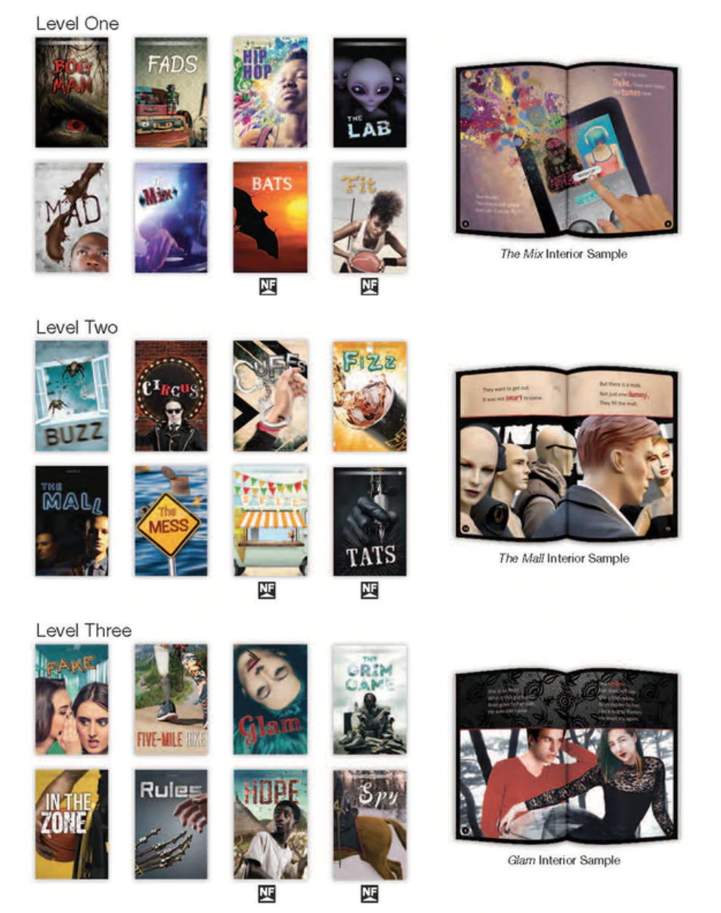
Where are your students at?

Slide 36
Transitioning students from DECODE to DEVELOP
Level One
Level Four
Level Two
Level Five
Level Three
Level Six

Slide 37
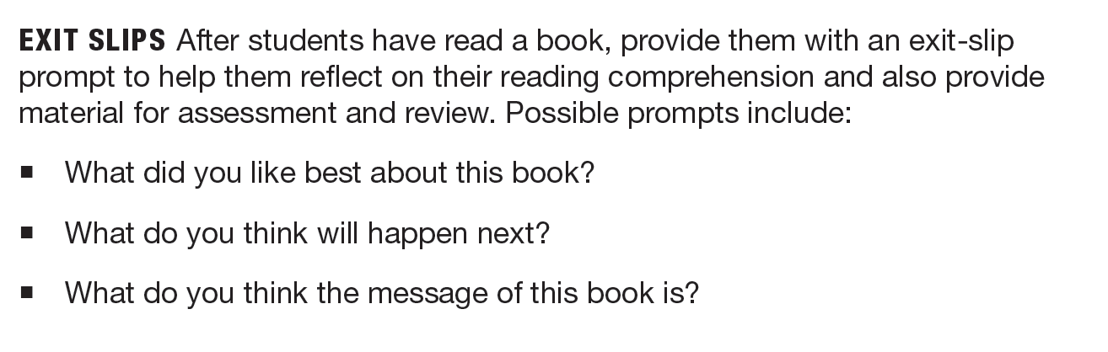
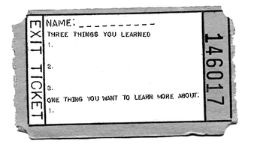
Strategies for starting or ending a lesson
Read aloud from a chapter book (short discussion).
Mini phonics lesson that corresponds with the book being read.
  Explain. Model with an example. Ask students to practice with you (whole group).
Exit Ticket: Write down (or tell me) on a slip of paper, what you learned today about ea and ee words.

Slide 38
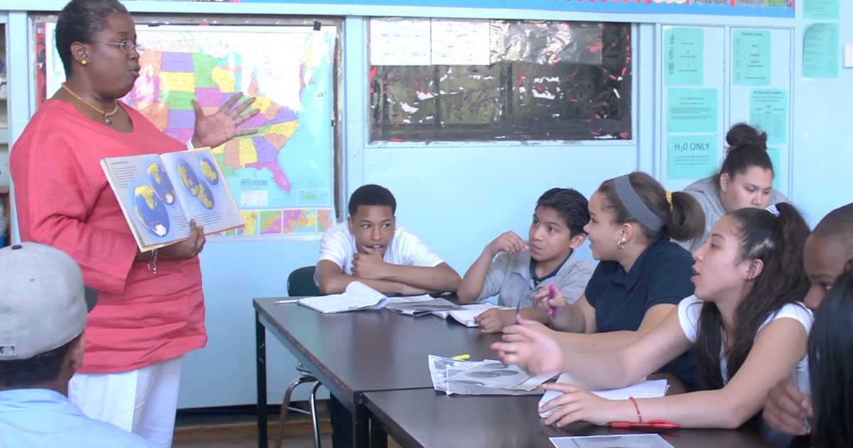
How to teach more comprehension?
Because many of our secondary students are still on the basic phonics level of reading, it is difficult for us to teach higher-level comprehension skills that our students so desperately need.
Read aloud to our students on a regular basis.
Article about the importance of reading aloud to older students:
https://www.commonsensemedia.org/blog/10-reasons-you-should-read-aloud-to-big-kids-too.
Exposing our students to chapter books with content that is at their age and cognitive level (but too difficult for their actual reading level) enables our students to gain the benefits of learning to think while they “read/listen" and to develop comprehension skills—even though they can’t read chapter books yet.

Slide 39


Reading Aloud to your students
If reading aloud to your students is a challenge for you or intimidating, you can often find books read aloud on YouTube that you can play for your students from your phone on high volume or a computer with speakers.
You can play a few minutes (5-12 min) every day for your students at the beginning of each class period and then facilitate a short discussion about what they listened to each day.
Even though your students may balk at this practice at first, I have witnessed how this changes over time and with consistency as students warm up to the idea—and end up LOVING it!
When my students started enjoying this part of the lesson, they were motivated to show up on time for class (because they didn't want to miss the read aloud) and didn't want to be absent to school (for fear of missing out on what would happen next in the book).

Slide 40
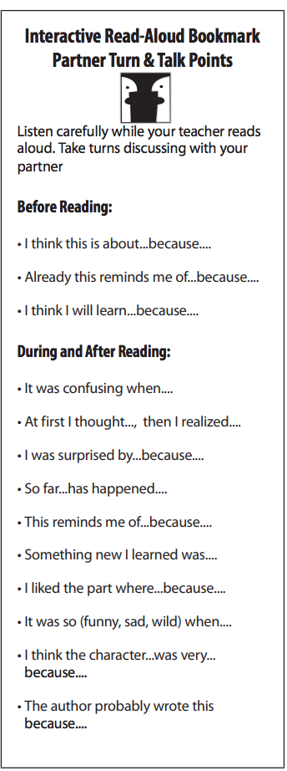
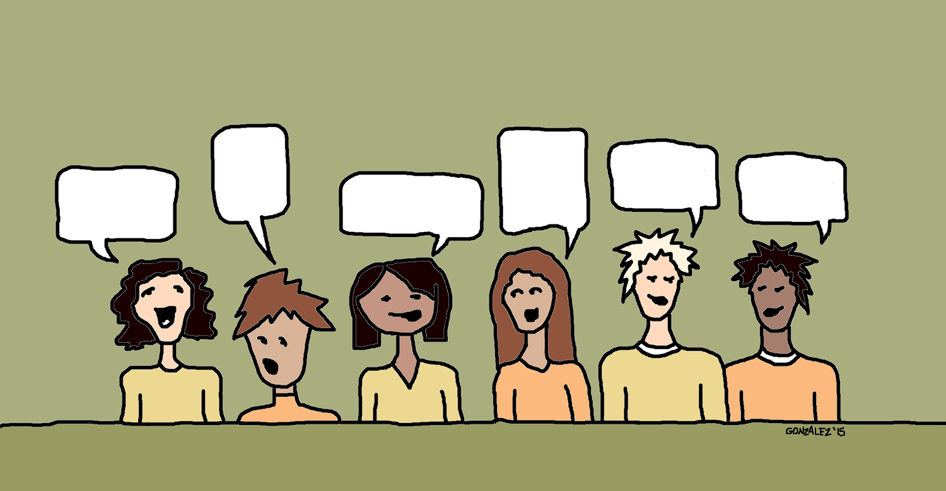
Class discussion to facilitate comprehension
To facilitate class discussions about the read aloud, the bookmarks (p. 26) from the PDF are excellent prompts to get your reluctant students talking with confidence about what they listened to.
These prompts should be given verbally with the expectation that responses should be given verbally too.

Slide 41
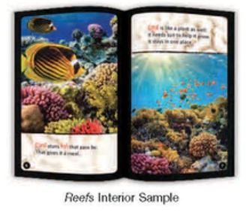
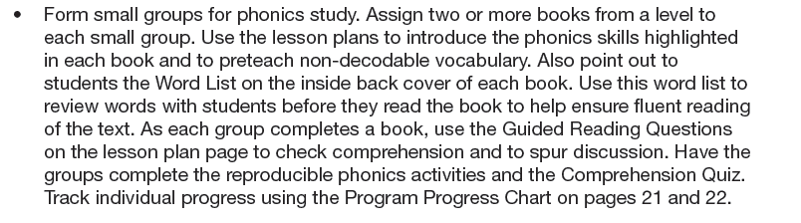
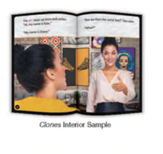
Implementation Options: what works for you and your students?

Slide 42
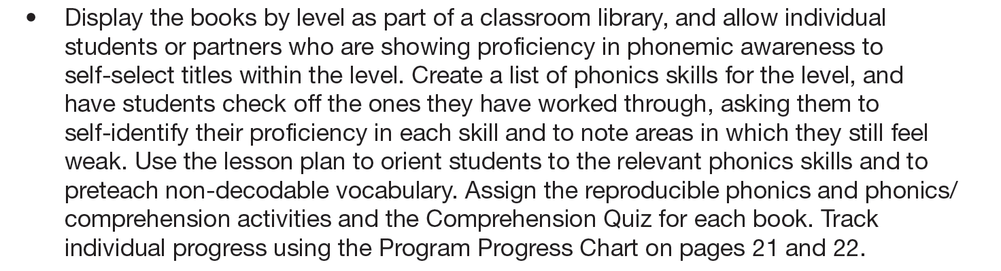
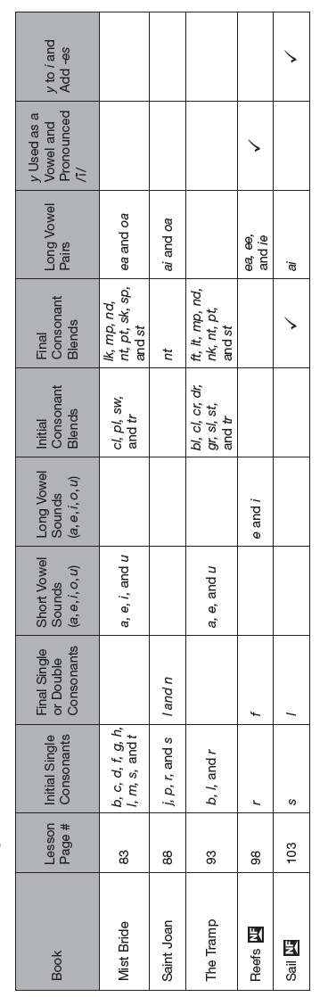
When students own their own learning.

Slide 43
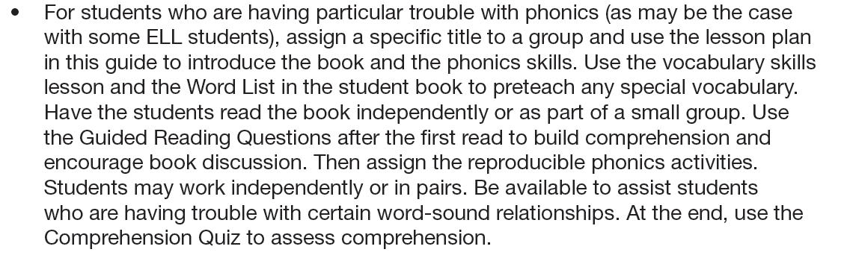

Pre-read, read, re-read.

Slide 44



Do remedial reading students have access to books?
How can you provide more picture books, graphic novels, and comics from the school library to your students?
Will the school library loan you a stack of books for a few weeks to give students access to read ones that may interest them WITHIN your classroom?

Slide 45

Improve reading skills with comic books
Nothing helps strengthen reading mastery more than practice.
Research shows that comic books and graphic novels provide students with reading practice, and students are much more motivated to read bright, colorful comics with less text. Yet, they are still reading!
With graphic novels, students use text and images to make inferences and synthesize information, both of which are abstract and challenging skills for readers.
Could free, independent reading (with comics and graphic novels) be one of your rotation stations?

Slide 46

Phonemic Awareness Strategies, p. 18
Look underneath your chair for the following Phonemic Awareness strategies.
If you have one of the following, read your strategy out to the whole group.
1. Rhyme identification
2. Matching activity
3. Round-robin activity
4. Word parts recognition
How can I use the resources from the kit to make these strategies more hands-on and fun?

Slide 47


Phonics Strategies, p. 18-19
Could I use these strategies as a learning station rotation?
Look underneath your chair for the following Phonics strategies.
If you have one of the following, read your strategy out to the whole group.
1. Letter Hunt
2. Word lists
3. Word descriptions

Slide 48

Comprehension Strategies, p. 19-20
Look underneath your chair for the following Comprehension strategies.
If you have one of the following, read your strategy out to the whole group.
1. Preview the text
2. Listen-read-discuss
3. Exit slips
I’m seeing…
I’m wondering…
I’m thinking…
I’m noticing…
I’m feeling…

Slide 49

Vocabulary Strategies, p. 20
Look underneath your chair for the following Vocabulary strategies.
If you have one of the following, read your strategy out to the whole group.
1. Picture Game
2. Word Circle Diagram

Slide 50

Fluency Strategies, p. 20
Look underneath your chair for the following Fluency strategies.
If you have one of the following, read your strategy out to the whole group.
1. Echo reading
2. Choral reading

Slide 51

Your Turn: Lesson plan stations
Choose a book from the DEVELOP box.
Browse the lesson plan and worksheet in the Teacher’s Manual for the corresponding book.
Develop at least 4 interactive learning stations (one with YOU at) with activities that directly correlate to the lesson objectives/book you chose.
Write up each station’s directions.
Be ready to share your lesson plan with the whole group.

Slide 52
Group Activity:
Objective: Work in groups (of 3) to prepare a lesson plan using at least two items from the Kit with one of the Decode or Develop books.
On the chart paper, list the directions for each station’s activity and what you hope your students to learn through the activity. (20 minutes)
Be ready to share with the group the chart paper and explain how they would implement their lesson plan.

Slide 53
Title of Book
Station 1 Activity:
Directions
What I hope my students learn from this activity…
Station 2 Activity:
Directions
What I hope my students learn from this activity…
Station 3 Activity:
Directions
What I hope my students learn from this activity…
Station 4 Activity:
Directions
What I hope my students learn from this activity…
Consider specific ways to hold your students accountable for station rotation time (minimums, incentives, check-ins, etc.)

Slide 54
Group Presentations:
Provide positive feedback about each lesson plan presented.

Slide 55
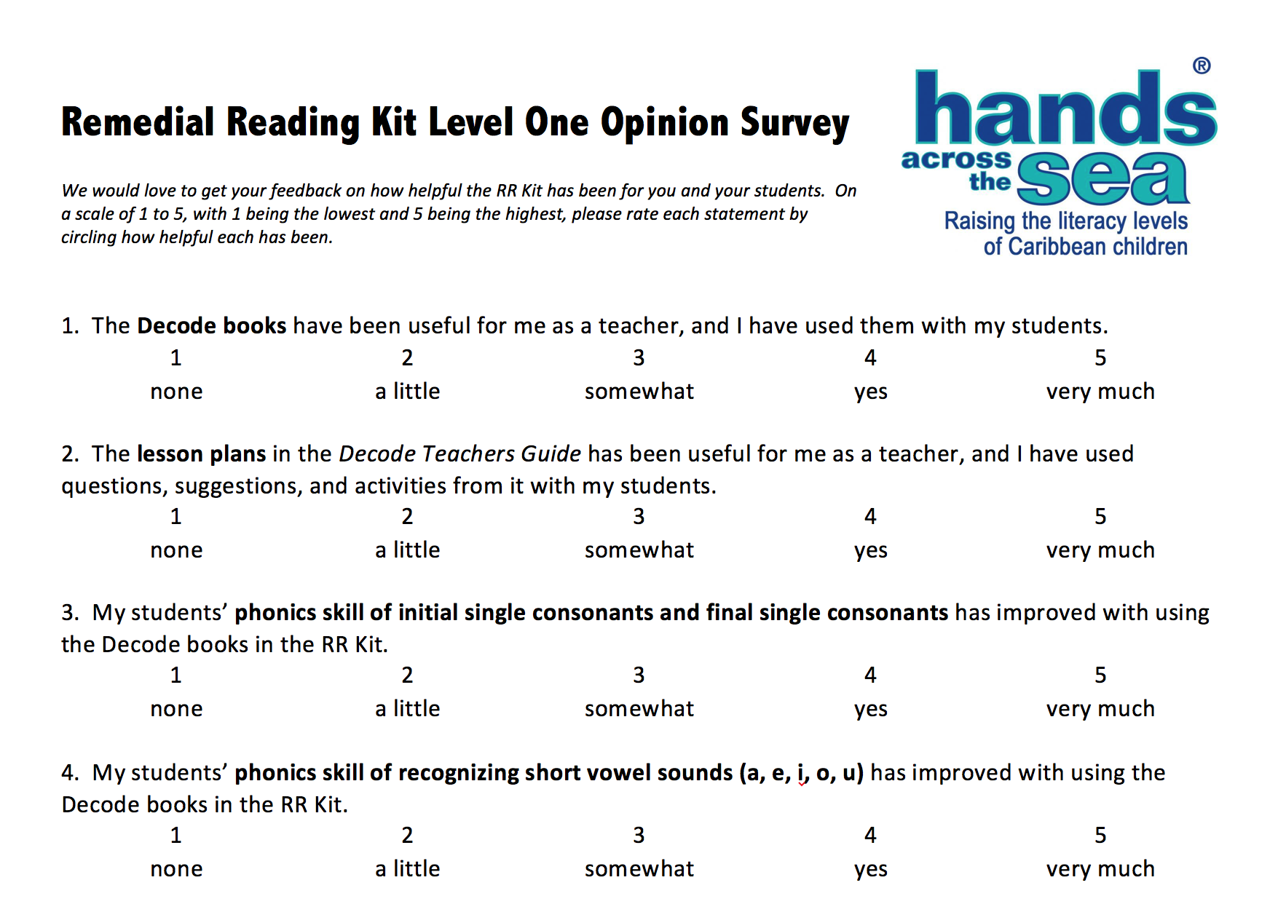

Slide 56
